Slide 1

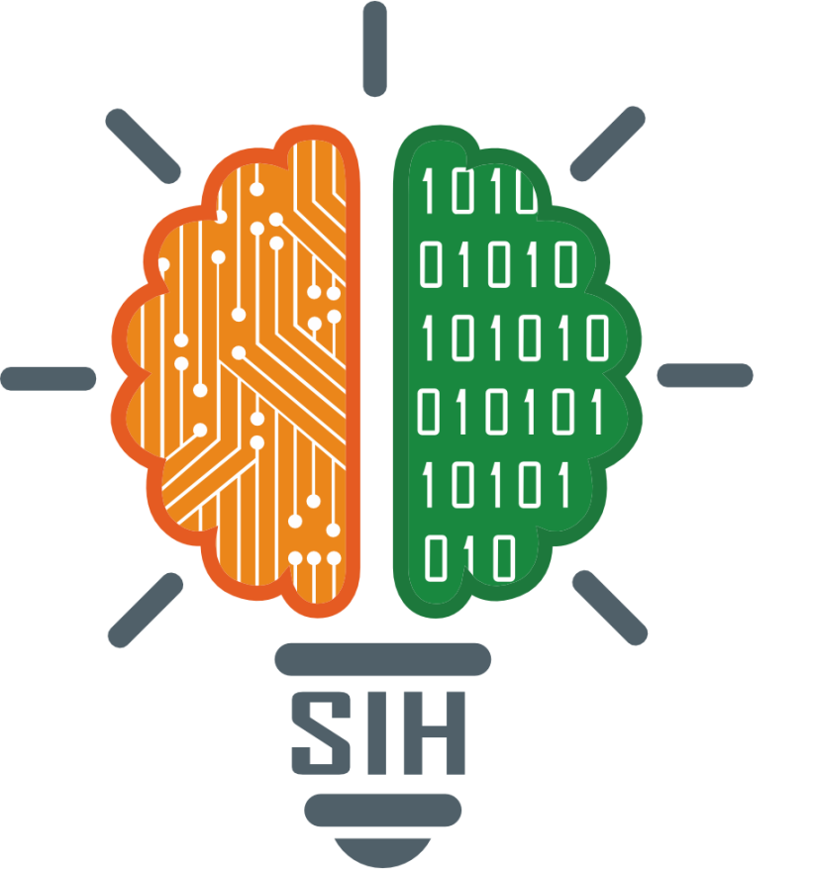
SMART INDIA HACKATHON 2025
TITLE PAGE
Problem Statement ID – SIH25049
Problem Statement Title- AI-driven public health chat bot for disease awareness
Theme- Med Tech
PS Category- Software.
Team ID- CS-B 03
Team Name (Registered on portal): Impact Ignitors

Slide 2
Impact ignitors
AI DRIVEN PUBLIC HEALTH CHATBOT FOR DISEASE AWARENESS
Proposed Solution: -
AI analyzes the message using smart language processing.
Shows possible diseases and simple home care advice.
Displays real-time outbreak map based on user location.
Corrects health myths with clear, trusted facts.
Sends health tips and preventive reminders.
Supports local languages and voice input for easy use.
User types or speaks their health issue.
Provides emergency contact.
Tracks user health over time and give periodic reports.
Our Solution: -
Integrated with govt. health databases for real-time updates.
Cloud-based & scalable, ensuring 24/7 access.
Multilingual + voice support for inclusivity.
Privacy-first: anonymized and encrypted data.
20% rise in awareness in target areas.
80% accuracy in answering queries.
@SIH Idea submission -Template

Slide 3
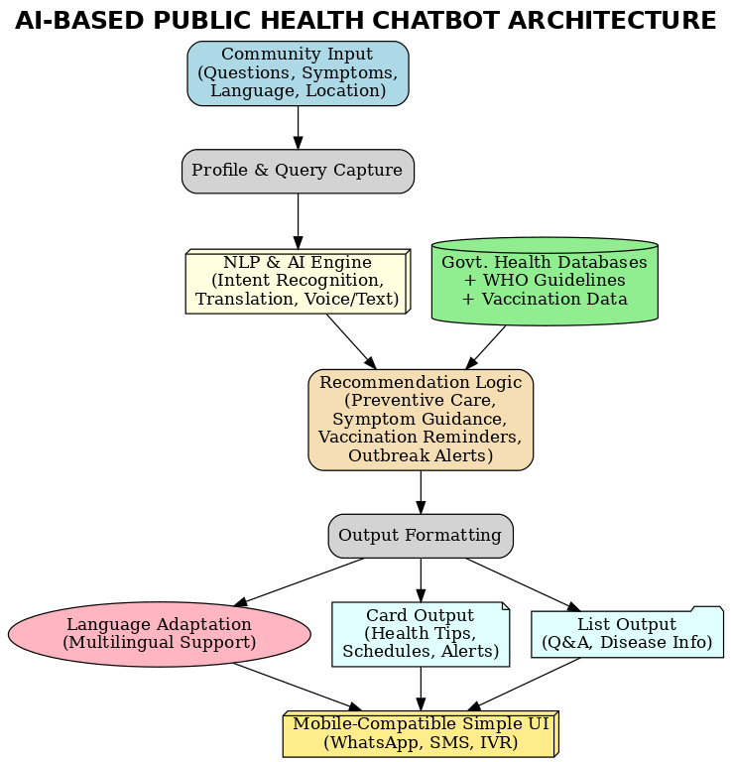
TECHNICAL APPROACH
Impact Ignitors
Technologies Used: -
Languages: Python, JavaScript (Node.js)
Frameworks: Rasa/Dialogflow (NLP), Hugging Face (mBERT/XLM-R), FastAPI/Flask (backend)
Databases: PostgreSQL, Redis
Methodology and Implementation: -
Requirement Analysis & Development→ Define intents, entities, languages, build NLP models, backend, databases
Integration & Testing→ connect WhatsApp/SMS APIs & govt. health databases. Accuracy (≥80%), pilot deployment
Deployment → cloud hosting with scaling(Kubernetes/Serverless)
Monitoring & Improvement → analytics, updates, continuous learning

Slide 4
FEASIBILITY AND VIABILITY
Impact Ignitors
Feasibility:
Technically achievable (Rasa/Dialog flow,WhatsApp/SMS API’s, Hugging Face, cloud).
Works on smartphones and feature phone.
Cost-effective and socially impactful.
Viability:
Low-cost deployment (open-source + cloud/SMS).
High social impact (awareness, vaccination, outbreak alerts).
Scalable & sustainable (new languages/diseases can be added easily).

Slide 5
IMPACT AND BENEFITS
Impact Ignitors
Reduces the spread of false health information by giving science based facts
Improves access to health awareness in rural and remote areas
Supports local languages and voice input for easy use by everyone
Tracks user health over time and provides useful periodic health reports
Saves time and cost by preventing unnecessary hospital visits
A smart, fast, and easy Chat bot that helps people stay safe, informed, and in control of their health
.

Slide 6
RESEARCH AND REFERENCES
Impact Ignitors
Research:
AI chatbots improve health awareness and vaccination rates.
Multilingual NLP (mBERT/XLM-R) supports local languages.
Integration with government health data ensures accuracy.
USSD/IVR or SMS-based alerts reach users without internet.
References:
Bibault et al., “Chat bots in healthcare: A review.” NPJ Digital Medicine, 2019
Miner et al., “Smartphone-based AI interventions for health promotion.” JMIR, 2020
Devlin et al., “BERT: Pre-training of Deep Bidirectional Transformers.” 2019
Conneau et al., “XLM-R: Cross-lingual Language Model Pretraining.” 2020

